Slide 1
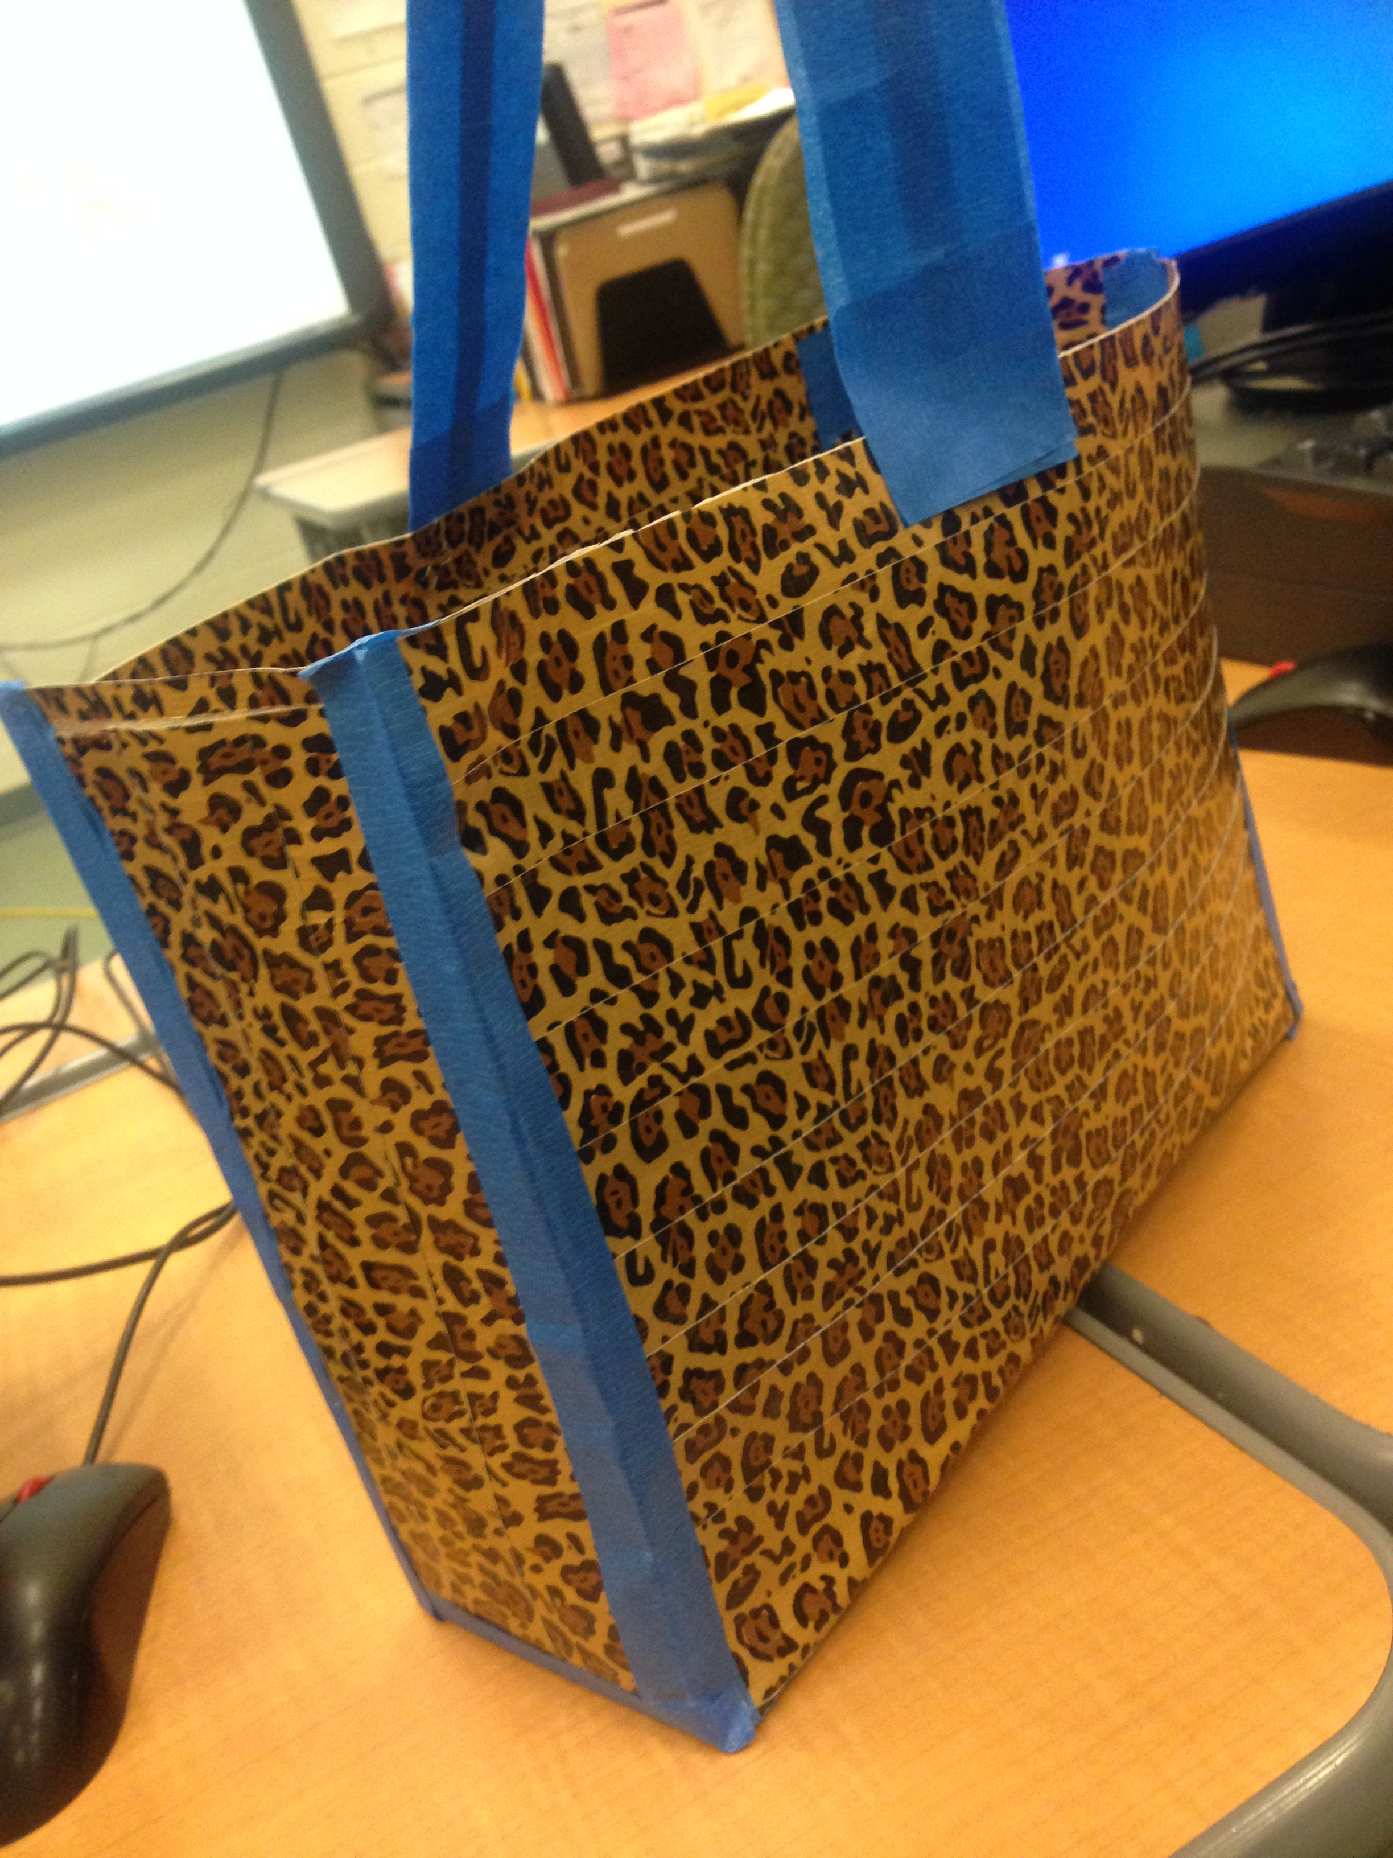
How To DEISGN a tote bag out of duct tape
By: Dakota Woods
2nd period

Slide 2
Define the Problem
The problem to solve is to construct a sturdy tote bag out of duct tape. The tote bag has to be able to hold items without breaking.

Slide 3
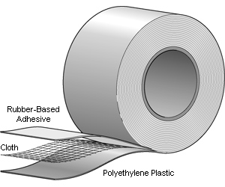
Background Research
I researched why duct tape would be a good material to create a bag with. According to Yale Scientific, Duct tape may just be the “ultimate material.” This sticky and versatile adhesive is useful in everything from making prom formalwear to covering heating and cooling ducts to removing warts. According to the Duck brand company’s recipe, duct tape is comprised of three different layers. The outermost layer contains a waterproof polyethylene film. Next, the middle layer is a strong, cloth mesh. Finally, the most expensive component of duct tape is its rubber based adhesive layer.

Slide 4
Specify Requirements
The tote bag has to be made out of duct tape and able to use daily to carry your items.

Slide 5
Brainstorm Solutions
First Solution:
Choose Duck Brand printed duct tape.
Second Solution:
Choose Safari Brand duct tape.
Third Solution:
Choose Scotch Brand duct tape.

Slide 6
Choose the Best Solution
After researching the different brands, I came to the conclusion that using Duck Brand duct tape would be the best solution. Then I researched different ways to make the tote bag. I found the best way to make it on Howcast.

Slide 7
Construct a Prototype
Step 1 Make sheets of tape- Cut eight long strips of tape to your desired bag width. Place the strips, sticky side down, on your cutting board, overlapping the strips by 1 inch to make sheets of duct tape fabric.
Step 2 Overlap sheets of tape- Flip the sheet over and cover the sticky side with another layer of overlapping tape strips. No sticky sides should be visible when you’re finished.
Step 3 Repeat the steps- Make another sheet of duct tape fabric the same size as the first for the tote bag body, and then make two smaller sheets for the sides and one for the bottom.
Step 4 Fasten the pieces together- Lay one of the large pieces on top of the other and then join the body of the tote to the side pieces and the bottom by folding small pieces of tape around the three sides, leaving the top open.
Step 5 Make the handles- Cut two 20-inch pieces of tape and fold each piece in half lengthwise. Attach the handles to the body of the bag with staples and then cover the staples with tape.
Step 6 Decorate the bag- Use stencils and a pen to trace appliques onto complementary-colored tape. Cut out the designs with a utility knife and stick them onto your tote.
http://www.howcast.com/videos/326289-how-to-craft-a-duct-tape-tote-bag/

Slide 8
Test and Evaluate
Once it was complete, I tested the bag by holding it by the strap to make sure the strap stayed on. Then, I tested the sturdiness of the bag by adding as many items as I could.
The tote bag held up very well. The bag was very sturdy and supported the weight of the items.

Slide 9
Communicate Results
I gave a short presentation of my tote bag to my engineering class. I talked about my design process and how I constructed the bag. My classmates gave excellent feedback and gave me suggestions on how to improve my design.

